Slide 1


Bhagwan Mahavir College of Computer Application
PROJECT
TOPIC
TURISOUM DATA ANALYTICS
FOR POPULAR DESTINATION
Guided By : Asst. Prof. Sanket Trivedi Submitted By : Mr. Mayur Patil
Mr. Shyam italiya

Slide 2


Slide 3
Project Profile
PROJECT NAME | TURISOUM DATA ANALYTICS FOR POPULAR DESTINATION
Project Definition | Python analysis unveils India's tourism impact on economy & diverse attractions, empowering stakeholders with growth insights.
Internal Guide | Asst. Prof. Sanket Trivedi
Language | Python
Operating System | Windows 11
Tools | Jupyter Notebook
Submitted By | Mayur Patil , Shyam Italiya

Slide 4
PROBLEM DEFINATION
Poor infrastructure, including transportation, accommodation, and sanitation, can discourage tourists from visiting specific regions or attractions.
Marketing and Promotion: Insufficient promotion and marketing efforts may result in lower visibility of India's diverse tourist destinations, limiting their appeal to domestic and international travelers.
Seasonal fluctuations in tourist arrivals can strain resources during peaks and lead to underutilization during lows, impacting tourism businesses' sustainability.
Socio-cultural Impacts: The influx of tourists can sometimes disrupt local communities, traditions, and ecosystems, leading to social and environmental concerns.
Regulatory Framework: Complex regulations, bureaucratic hurdles, and inconsistent policies may create barriers for tourism businesses, hindering their growth and innovation.

Slide 5
PROBLEM SOLUTION
Investigates tourism's GDP contribution in India, analyzing both direct and indirect economic benefits. Quantifies sector's overall economic impact.
Explores tourism's role in job creation across hospitality, transportation, and entertainment sectors, emphasizing its importance in rural employment.
Identifies top tourist destinations in India, analyzes factors driving popularity, and explores tourist preference trends using data analytics.
Report guides policymakers on promoting tourism, suggesting strategies for infrastructure improvement, service enhancement, and overcoming growth obstacles.“
Report offers insights for tourism businesses, identifying market gaps, emerging trends, and innovation opportunities to meet evolving consumer demands.

Slide 6
PROJECT DESCRIPTION
Utilizes Python for in-depth data analysis of India's tourism sector.
Examines various dimensions of tourism using a comprehensive dataset.
Reveals insights into tourism's impact on India's economy and job market.
Analyzes the popularity of different tourist destinations across India.
Emphasizes the significant role of tourism in India's GDP and employment.
Highlights the diverse attractions in India, including wildlife expeditions, natural wonders, historical landmarks, and spiritual retreats.
Provides valuable insights for policymakers, businesses, and stakeholders to enhance India's tourism industry.

Slide 7
TECHNOLOGIES
Utilization of Python programming for data analysis.
Examination of diverse dimensions of tourism using comprehensive datasets.
Application of data analysis techniques to uncover insights into tourism's impact on India's economy

Slide 8
Scope of the project
Utilizes Python for data analysis.
Examines various dimensions of India's tourism sector.
Analyzes the impact of tourism on India's economy and job market.
Explores the popularity of different tourist destinations nationwide.
Emphasizes tourism's significant role in India's GDP and employment.
Highlights India's diverse attractions, including wildlife, natural wonders, historical landmarks, and spiritual retreats.
Provides insights for policymakers, businesses, and stakeholders to enhance India's tourism industry.

Slide 9
Data Analysis in TURISOUM DATA ANALYTICS FOR POPULAR DESTINATION

Slide 10
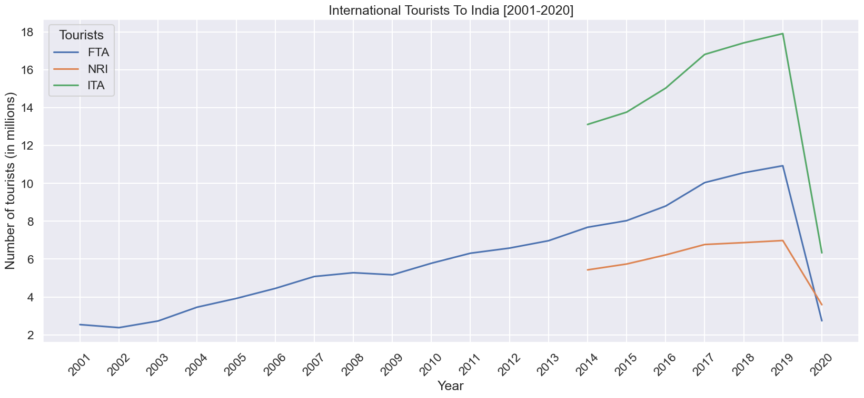
Statistics of International Tourists to India [2001 - 2020]
As we can see from the above Tourist arrivals in India steadily rose until 2020, when COVID-19 caused a significant downturn. Foreign Tourist Arrivals (FTAs) experienced double-digit growth in certain years but faced declines due to events like the 9/11 attacks and the 26/11 Mumbai attacks. Since 2014, the Ministry of Tourism has been tracking both Non-Resident Indian (NRI) and FTA arrivals.

Slide 11
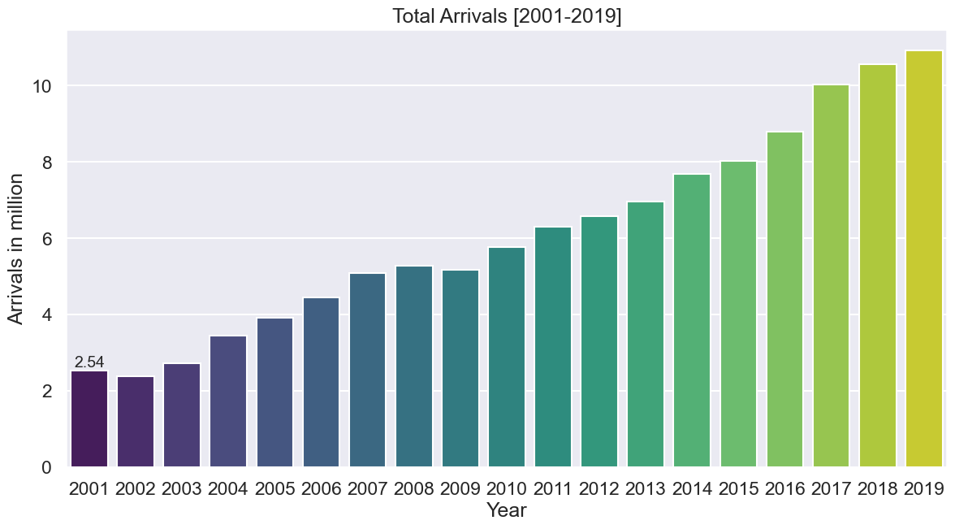
1.Quarterly Distribution of Tourists [2001 - 2019]
As we can observe from the above bar plot, tourism has been improving in India even if there were a few exceptions during certain years.

Slide 12
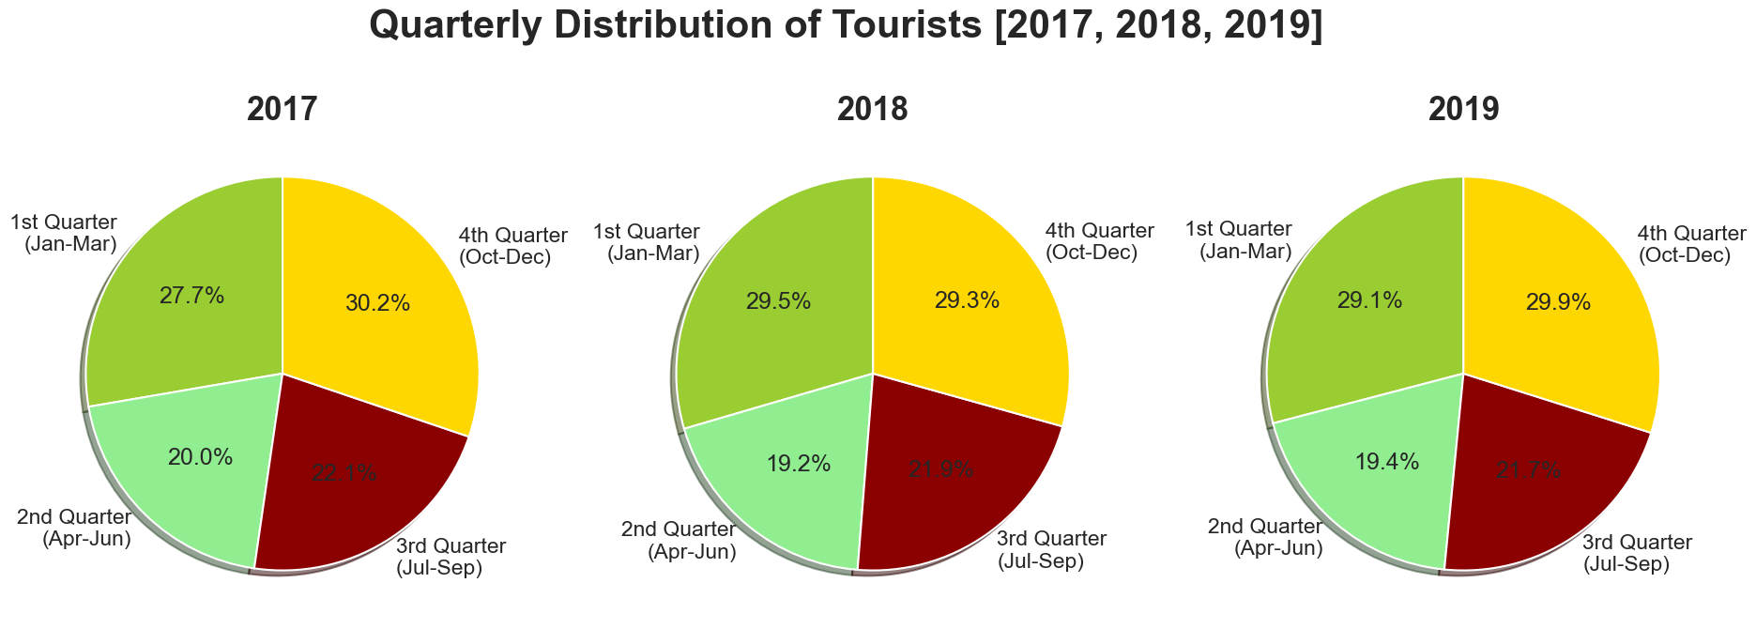
2.Quarterly Distribution of FTAs during 2017, 2018 and 2019
According to the pie charts provided, Foreign Tourist Arrivals (FTAs) in India peaked during the winter season, specifically in the 4th Quarter (October-December) and the 1st Quarter (January-March). This period is considered the best time to visit India due to favorable weather conditions and temperatures. Conversely, FTAs were lowest during the summer season, particularly in the 2nd Quarter (April-June), attributed to the heat during these months. This trend was observed consistently across the years 2017, 2018, and 2019.

Slide 13
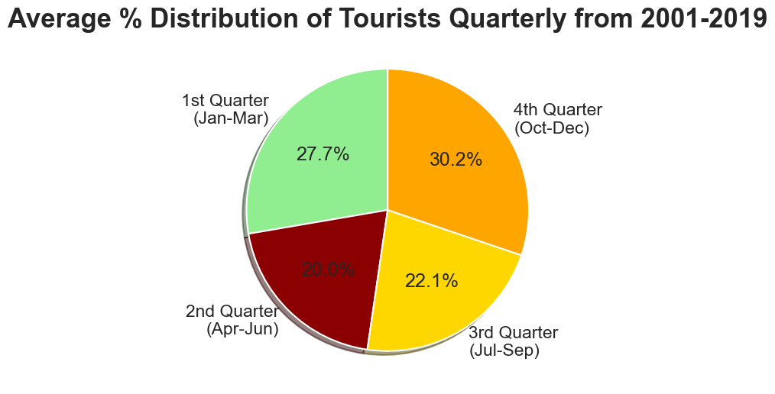
3.Average Percentage Distribution of FTAs Quarterly [2001 - 2019]
As per the pie chart, we can observe that on an average, the number of FTAs during the winter season has been the highest while it was the least during the Winter season from 2001 to 2019.

Slide 14
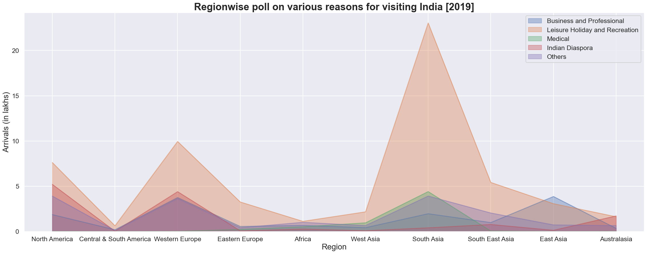
C. Statistics of ITAs to India based on purpose 2019-
1.Statistics of ITAs to India based on purpose 2019 [Region Wise]
South Asia, particularly Bangladesh, leads in tourist visits to India for leisure, with medical tourism also thriving due to low costs, quality infrastructure, skilled doctors, and diverse therapies. India ranks among the top three medical tourism destinations in Asia, with English-speaking doctors reducing language barriers for foreign patients.

Slide 15
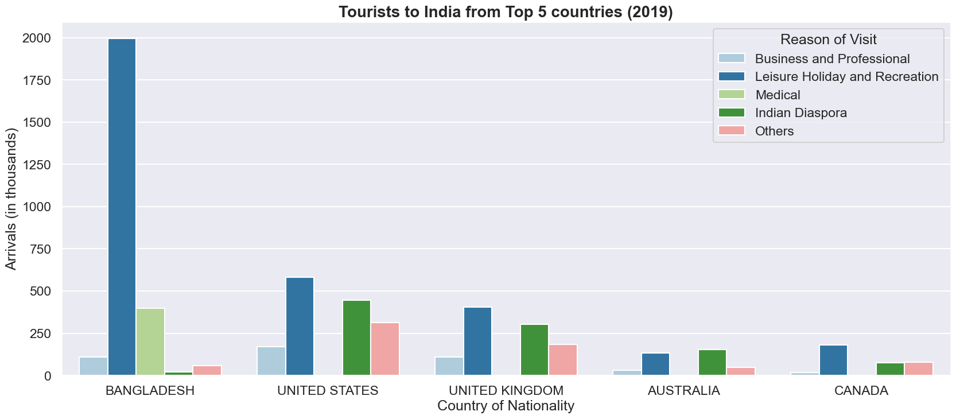
2. Tourists to India from Top 5 countries - 2019:
Bangladesh emerges as the top contributor to India's tourism sector, with leisure being the primary reason for visits. India's Ministry of Tourism's 'India Tourism Statistics at a Glance 2021' report confirms Bangladesh's significant share, accounting for 23.6% of total foreign tourist visits to India, making it the primary source of international tourists to the country.

Slide 16
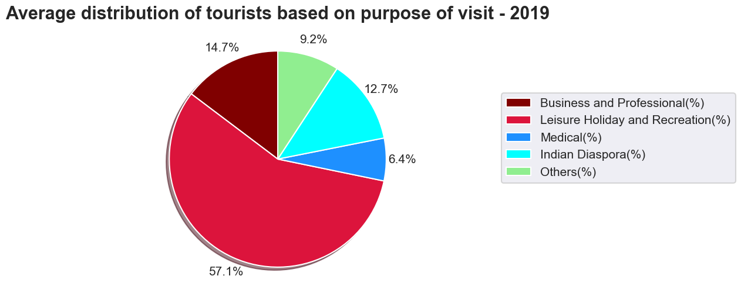
3. Average Distribution of Tourists to India based on the purpose of visit -2019:
The pie chart indicates that leisure is the primary motive for most tourists visiting India. With its diverse offerings, each Indian state boasts unique attractions ranging from natural wonders to historical landmarks and spiritual sites. These varied experiences make India an ideal destination for leisure travelers seeking memorable and enriching experiences during their visit.

Slide 17
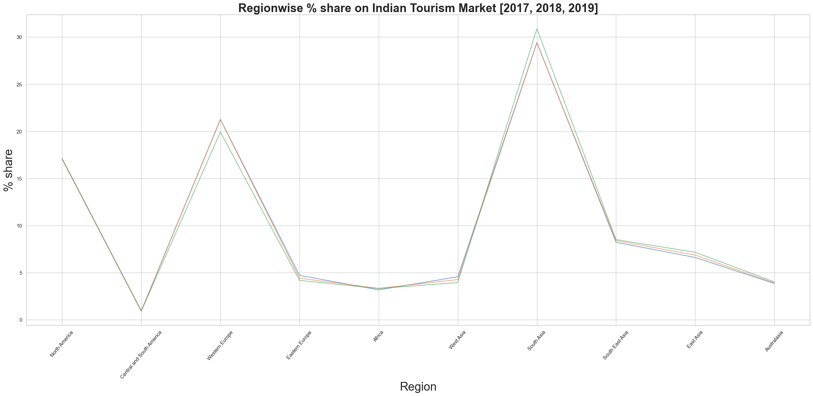
D. Contribution Statistics to the Share Market of Indian Tourism [2017 - 2019]-
1. Contribution to the Share Market of Indian Tourism region wise [2017 - 2019]:
The multi-line graph clearly shows that South Asia, Western Europe, and North America, particularly Bangladesh, the UK, USA, and Canada, make the most significant contributions to India's tourism share market. Since 2014, the inclusion of Non-Resident Indians' arrivals in the definition of International Tourist Arrivals has bolstered the numbers, leading to an enhancement in contributions to India's tourism share market. This demonstrates the importance of accurately capturing tourist data for a comprehensive understanding of India's tourism industry's dynamics.

Slide 18
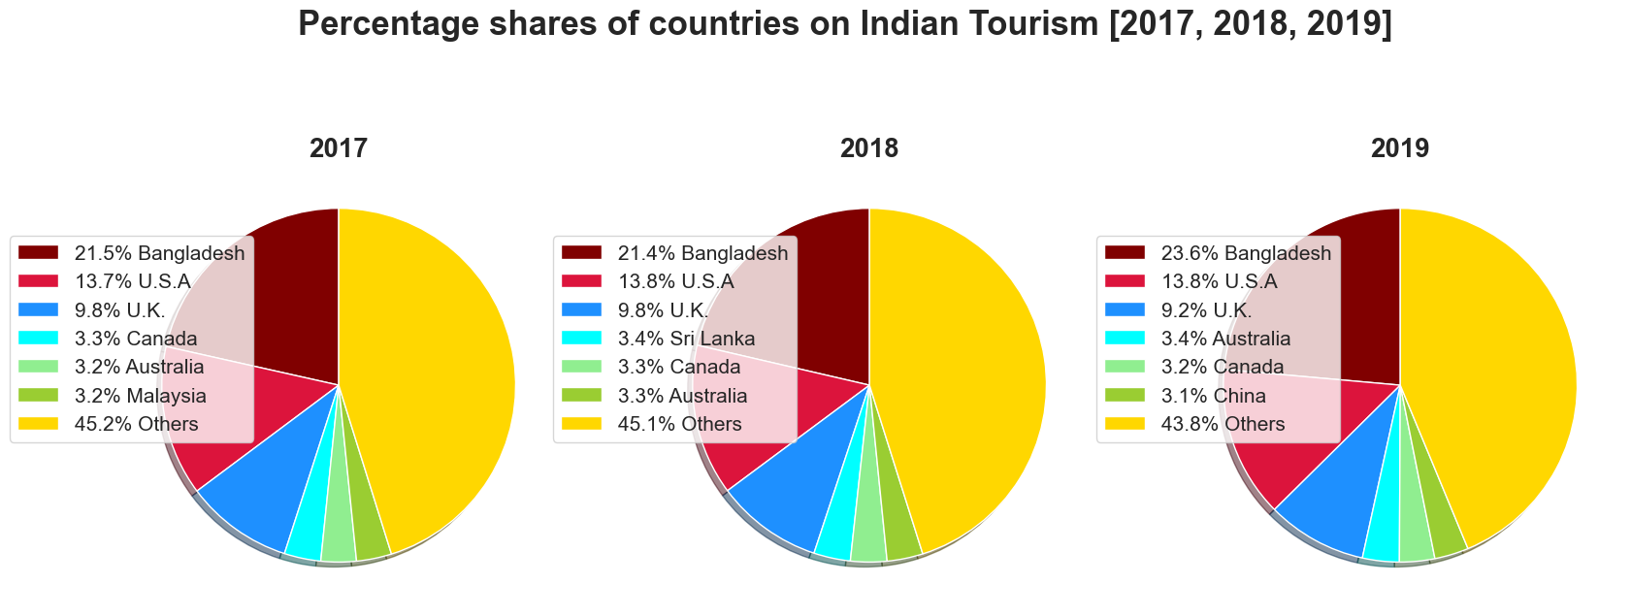
2. Contribution to the Indian Tourism Share Market country wise [2017 - 2019]:
From the above pie charts, we can infer that during the years 2017, 2018 and 2019, the contributions to the Indian Share Market by the Major countries has been constant with Bangladesh, U.S.A and U.K. on the lead

Slide 19
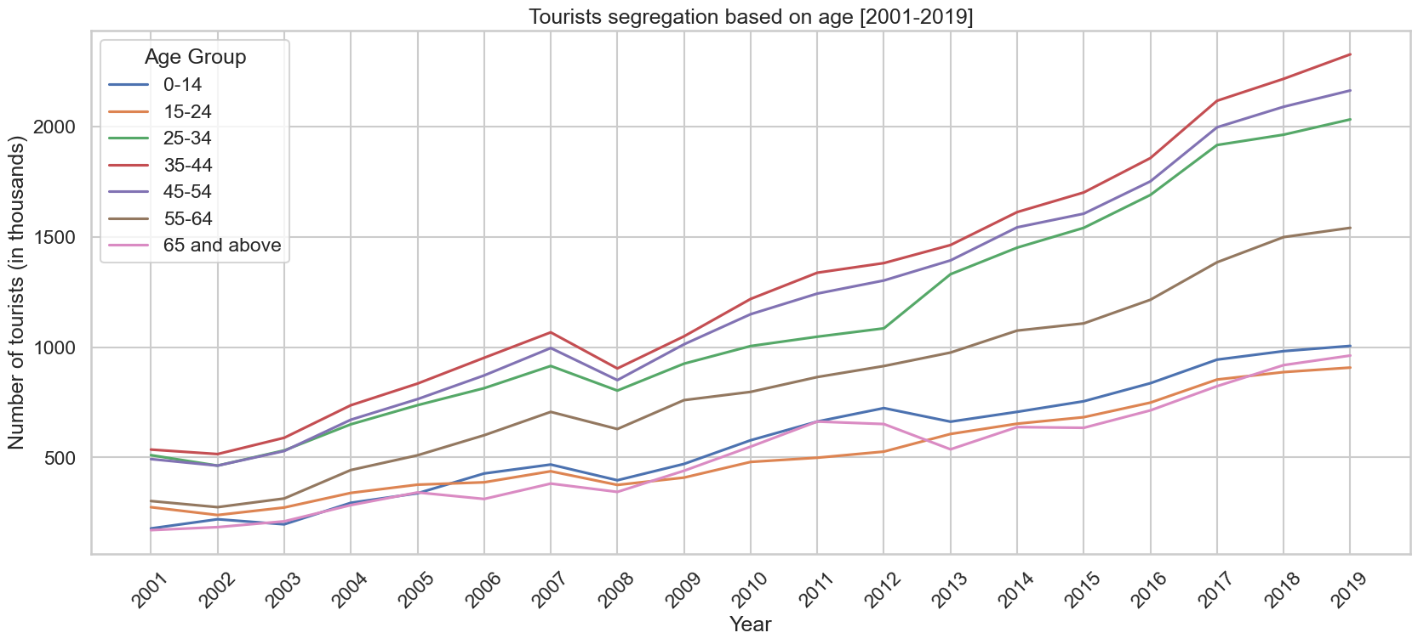
E. Tourist segregation based on age [2001 - 2019]-
1. FTAs segregated based on age [2001 - 2019]:
The multi-line plot indicates that the majority of tourists visiting India from 2001 to 2019 belonged to the late 20s to early 50s age group, with minimal variation observed in recent years. The highest number of Foreign Tourist Arrivals (FTAs) were recorded in the 35-44 years age group (21.0%), followed by the 45-54 years and 25-34 years age groups. Conversely, the lowest number of FTAs were observed in the age groups of 15-24 and 65 & above (8.7%).

Slide 20
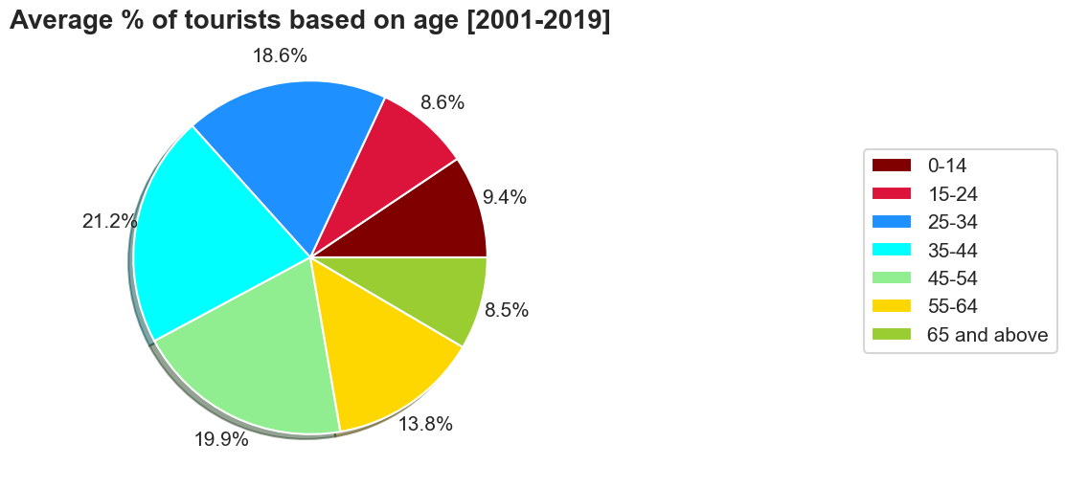
2. Average %age distribution of Tourists based on age [2001 - 2019]:
The pie chart suggests that a significant portion of tourists visiting India are youths and middle-aged individuals. While seniors may prefer more relaxing destinations, travel offers rejuvenation for them, similar to younger age groups. Challenges such as infrastructure, budget accommodations, and hygiene standards may deter potential travelers. However, young individuals could contribute significantly to Indian tourism, particularly through education. Improving India's education system could attract more international students, indirectly boosting tourism among the younger demographic.

Slide 21
F. Indian Tourism State Wise Statistics [2019 - 2020]: 1. Foreign tourists per State/UTs [2019 - 2020]:
As per the above horizontal barplot, it can be observed that during the year 2019, Tamil Nadu, Maharashtra, Uttar Pradesh, Delhi and others had the highest number of foregn tourists to their state. It can also be inferred that significant revenue was derived from Tourism in these states. Thus during 2020, due to Covid-19 restrictions, there was an enormous decrease in the Tourists which led to a huge blow to the Tourism sector in these states. Tamil Nadu has the largest tourism industry in India with a percentage share of 21.31% and 21.86% of domestic and foreign tourist visits in the country. Thus the steep decline in tourist traffic in 2020 on the advent of pandemic severely affected the Tourism sector of the state.

Slide 22
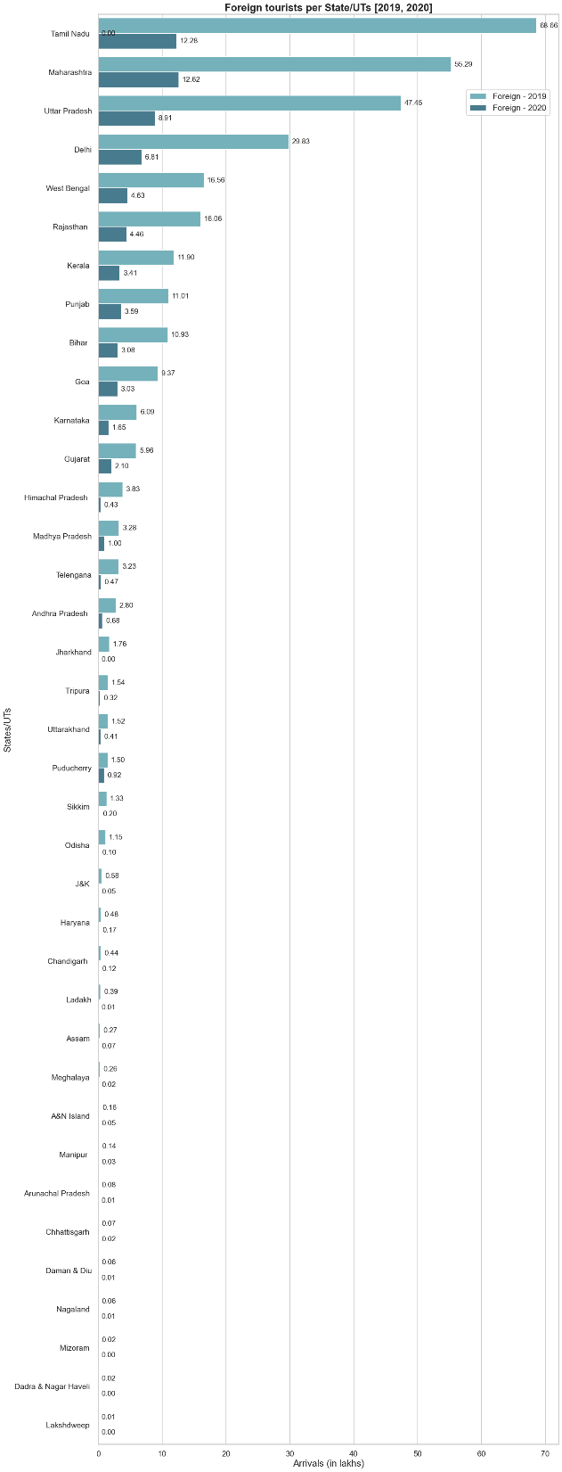

Slide 23
2. Domestic tourists per State/UTs [2019 - 2020]
The horizontal bar graph illustrates that in 2019, states like Uttar Pradesh, Tamil Nadu, Andhra Pradesh, and Karnataka attracted the highest number of domestic tourists, indicating significant revenue generation from tourism in these states. However, in 2020, the COVID-19 pandemic led to a substantial decrease in tourist arrivals, dealing a severe blow to the tourism sector in these states. Given that domestic tourism forms a significant portion of India's tourism industry, the impact of COVID-19 restrictions was profound, resulting in a sharp decline in tourism expenditure across inbound, domestic, and outbound categories. Uttar Pradesh, in particular, stood out in 2019, attracting a significant share of domestic tourists. However, the pandemic severely impacted tourist traffic in the state, affecting not only tourism but also the associated revenue and job opportunities.

Slide 24
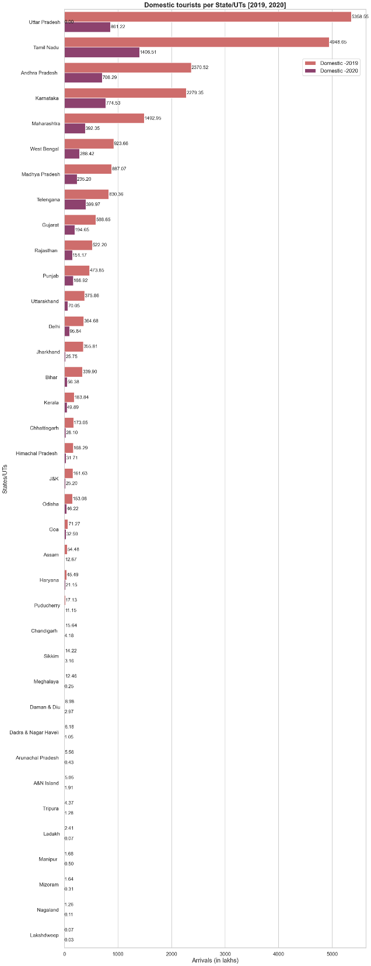

Slide 25
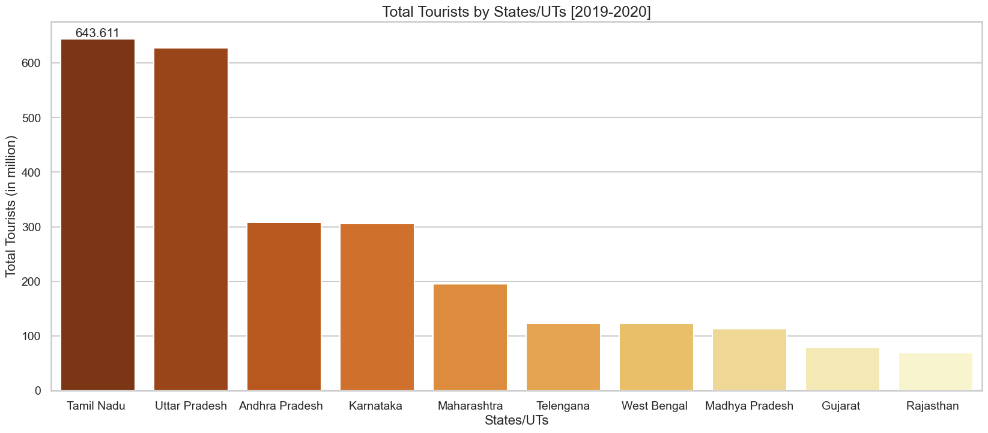
3. Total tourists per State/UTs [2019 - 2020]:
Thus from the above bar plot, it can be inferred that overall TamilNadu stood first in the
Tourism sector followed by Uttar Pradesh during the years 2019 and 2020 and it is the same
even now.

Slide 26
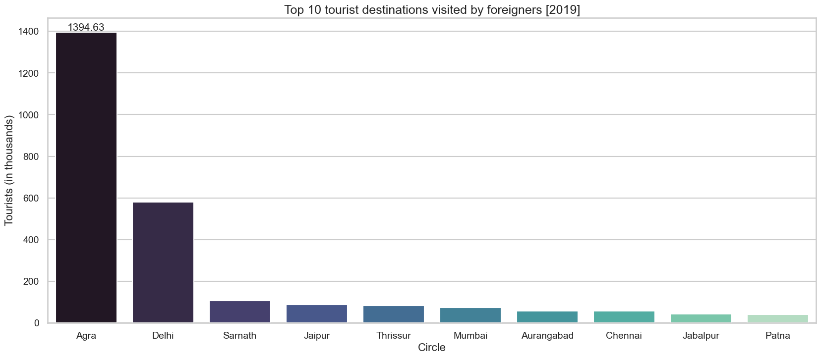
G. Popular monuments during 2019,2020,2021-
1. Top 10 Tourism Destinations visited by foreigners 2019:
The bar plot highlights Agra as the most popular tourist destination, closely followed by Delhi. This can be attributed to the presence of the Taj Mahal, India's most iconic monument, situated in Agra. Additionally, Delhi's proximity to Agra, combined with its own array of unique monuments and attractions, further enhances its appeal to tourists visiting India. The combination of these factors makes Agra and Delhi sought-after destinations for travelers seeking cultural and historical experiences.

Slide 27
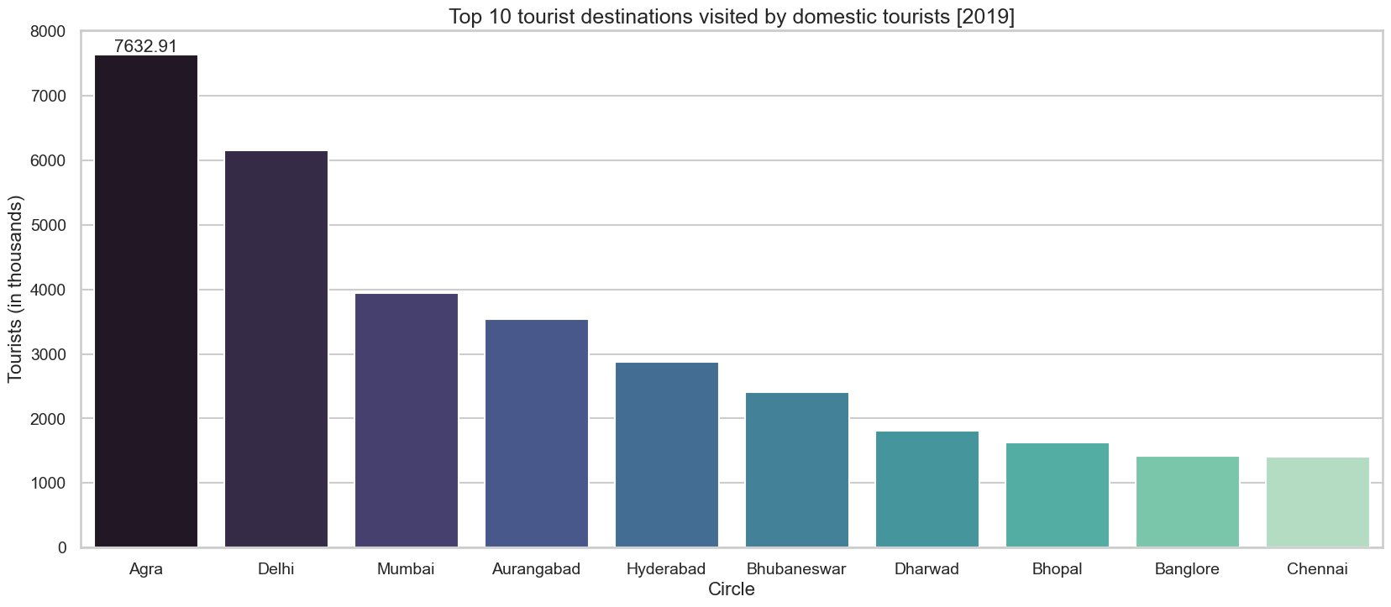
2. Top 10 Tourism Destinations visited by domestic travellers 2019:
The bar plot demonstrates a consistent trend, with Agra and Delhi maintaining their status as the most popular tourist destinations among domestic travelers. These cities, renowned for their cultural and historical significance, continue to attract a large number of visitors. In contrast, other popular tourist zones, often characterized by heritage sites or modern infrastructure, appear to be newer destinations that have yet to gain significant popularity among foreign tourists.

Slide 28
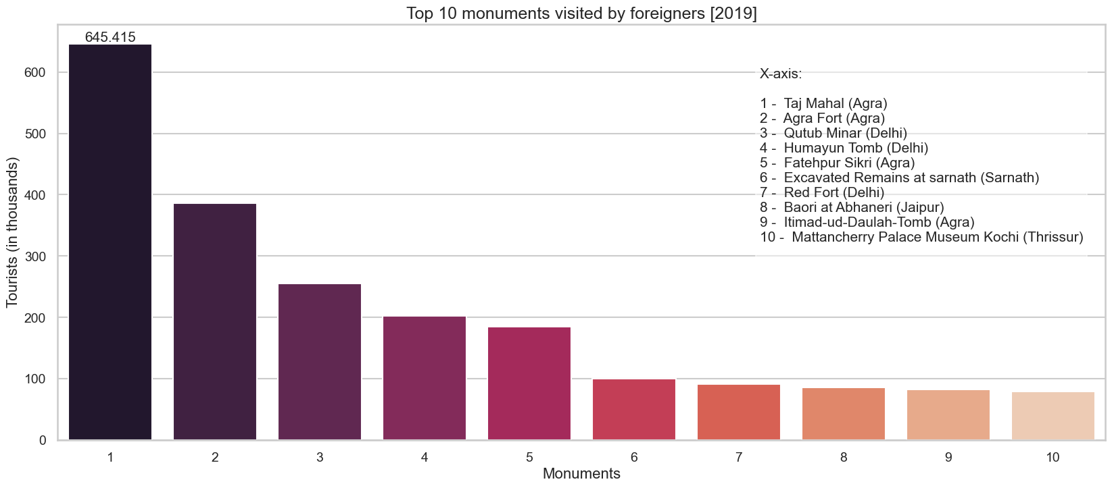
3. Top 10 Monuments visited by foreigners 2019:
As seen in the popular tourism destinations plot, it is evident from the above bar plot that most of the popular monuments visited by the FTAs are situated in Agra and Delhi, famous among them being one of the seven wonders of the world 'Taj Mahal'.

Slide 29
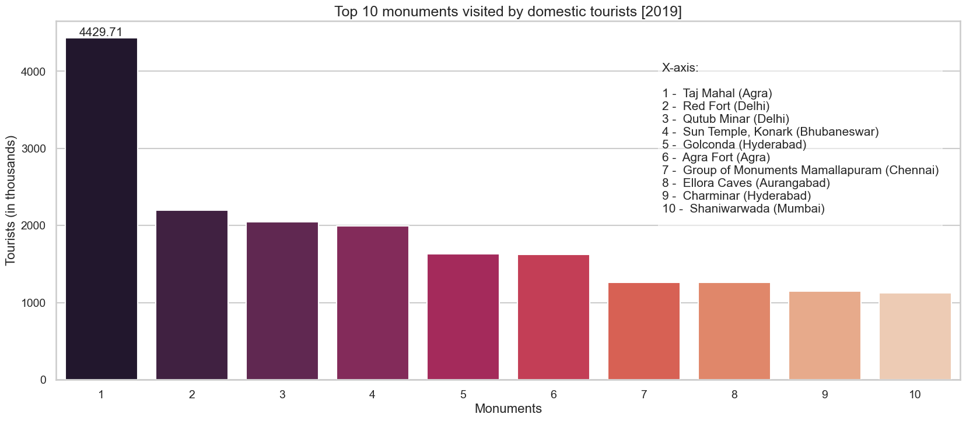
4. Top 10 Monuments visited by domestic travellers 2019:
The bar plot reflects a similar trend as previous graphs, with monuments in Agra and Delhi retaining their popularity among both domestic and foreign tourists. However, it's noteworthy that certain lesser-known monuments have captured the interest of domestic travelers. While North India dominates in terms of popular tourist destinations, states like Tamil Nadu, Andhra Pradesh, and Karnataka in South India also attract significant tourist footfall, particularly due to their impressive temples and cultural heritage. Despite its natural beauty and diversity, North-East India faces challenges in tourism development, including insufficient funds, infrastructure, and marketing efforts. With concerted government initiatives, North-East India's untapped tourism potential could be unlocked, showcasing its breathtaking landscapes and cultural richness to the world.

Slide 30
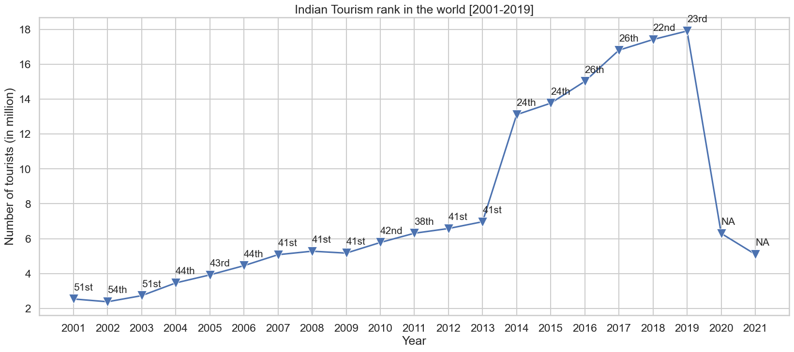
H. Position of Indian Tourism in the world [2001 - 2021]-

Slide 31
From the above line plot, we can observe that Indian Tourism was improving until
2020 as COVID-19 restrictions led to a steep decline in tourism. As NRIs were
included in the tourism statistics of India ever since 2014, there was a steep
increase in the number of tourists to India as well as its position w.r.t
Tourism in the world.

Slide 32
Conclusion
Since 2010, Indian tourism has seen significant growth due to increased investment in domestic and foreign tourism sectors, along with upgrades in transportation and hotel management. The COVID-19 pandemic caused a downturn, but there's optimism for recovery. To bounce back, India must prioritize enhancing tourism infrastructure, improving travel processes, and employing effective marketing strategies. Sustainable tourism practices are crucial for long-term success. Collaboration between the government, private sector, and local communities is essential. Leveraging India's diverse attractions and cultural heritage can establish it as a top global tourism destination. With strategic planning, India can emerge stronger post-pandemic.

